Slide 1
Q-Q (Quantile-Quantile) plot
Q-Q (Quantile-Quantile) plot is a graphical tool used to assess if a data set follows a particular theoretical distribution, commonly the normal distribution. It compares the quantiles of the data to the quantiles of the theoretical distribution. If the data matches the distribution, the points in the Q-Q plot will lie approximately along a straight line. Deviations from the line indicate discrepancies from the expected distribution, allowing easy identification of skewness, kurtosis, or other distributional anomalies. This helps in understanding data normality for further statistical analyses.
X-axis: Represents the theoretical quantiles from the specified distribution (often a normal distribution)
Y-axis: Represents the quantiles of your data.

Slide 2
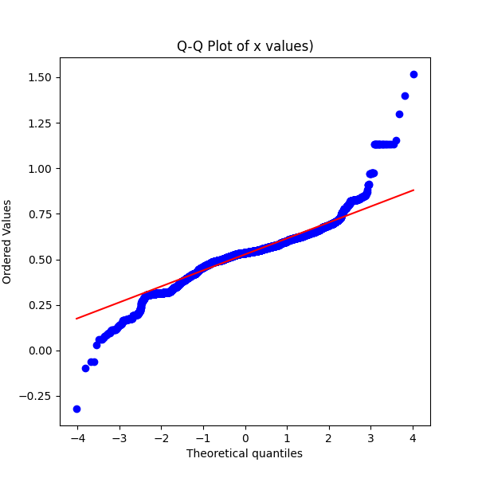
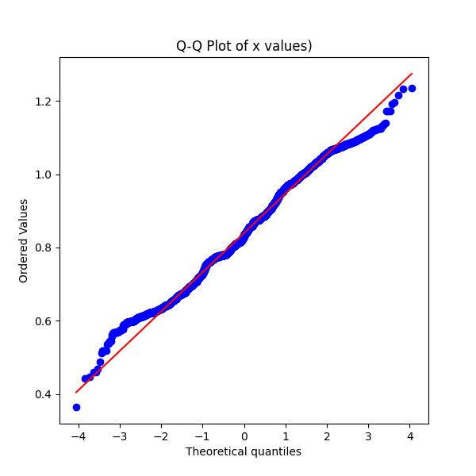
01-off
01-on

Slide 3
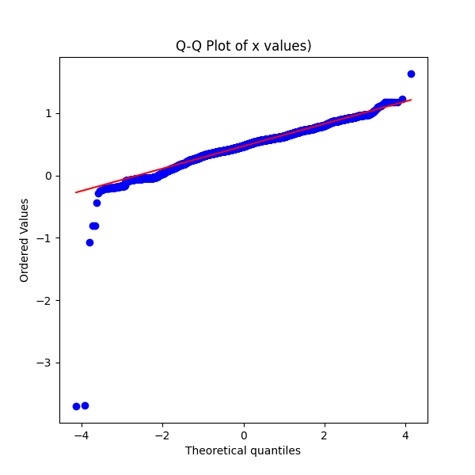
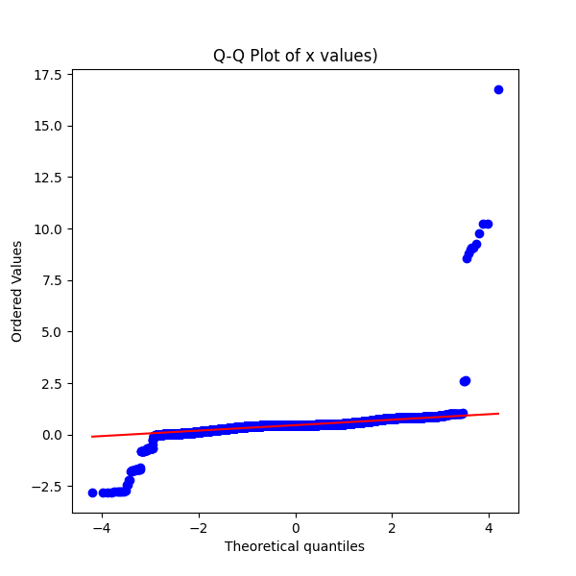
02-off
02-on

Slide 4
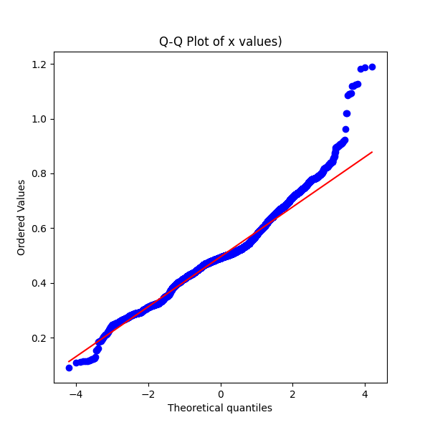
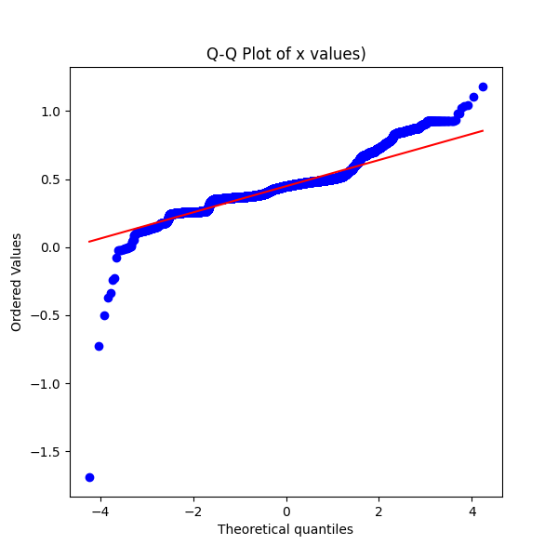
03-off
03-on

Slide 5
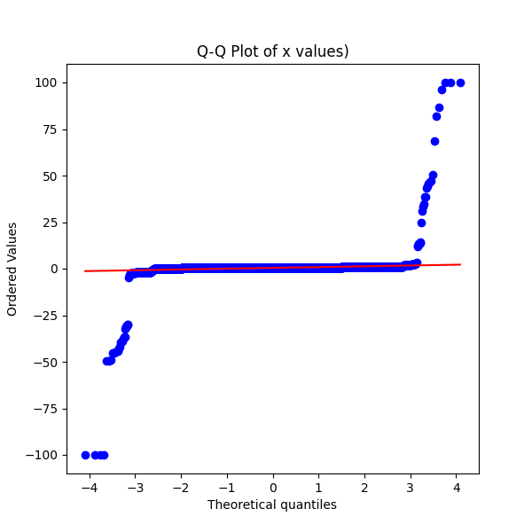
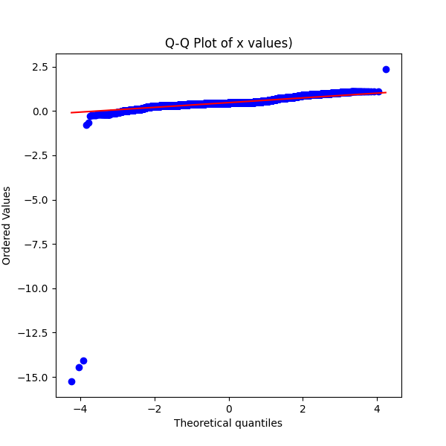
04-off
04-on

Slide 6
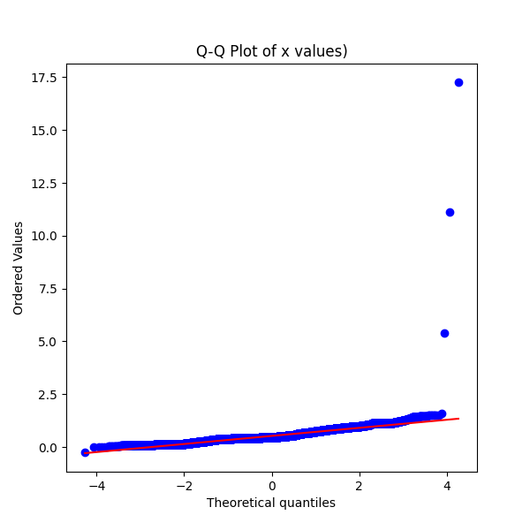
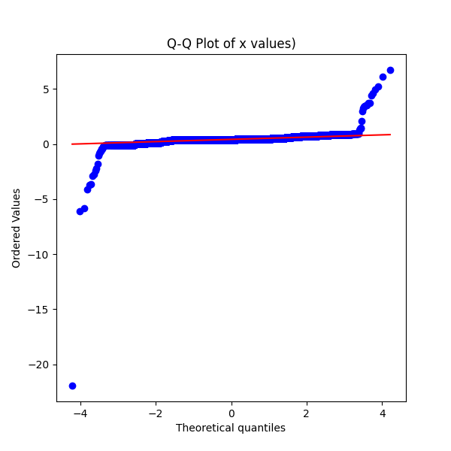
05-off
05-on

Slide 7
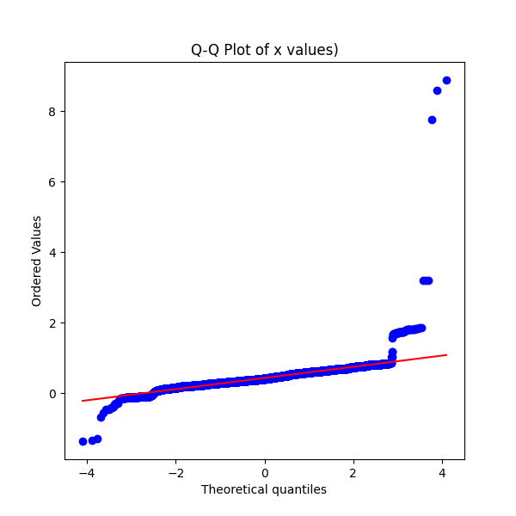
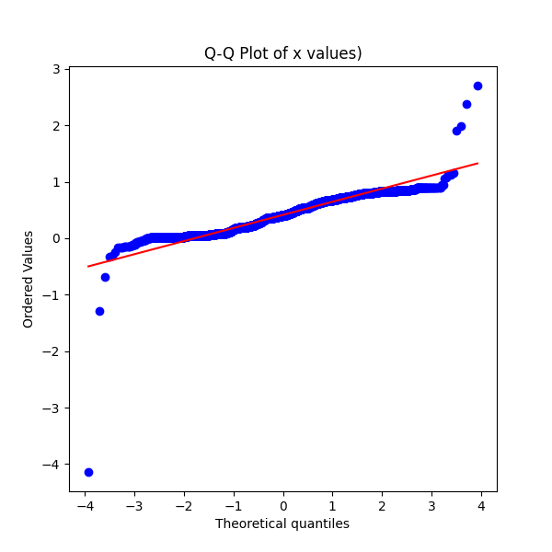
06-off
06-on

Slide 8
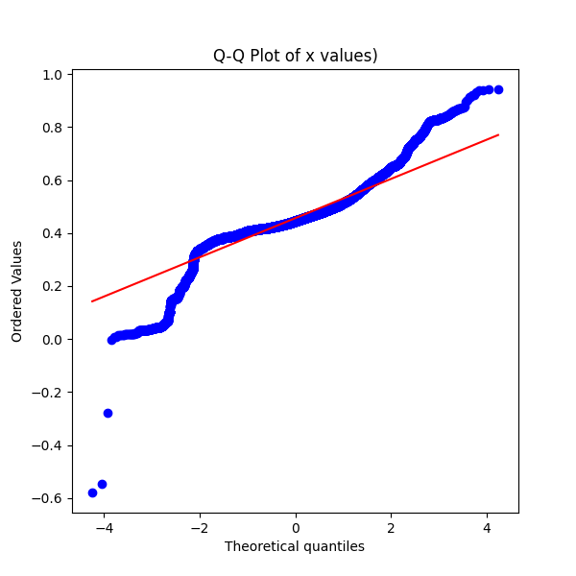
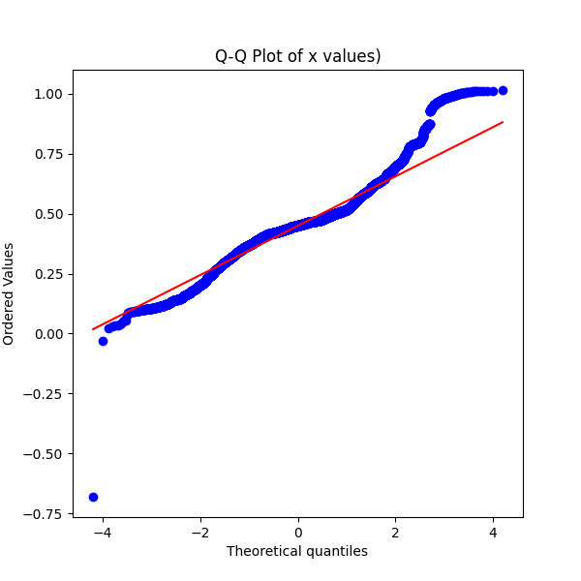
07-off
07-on

Slide 9
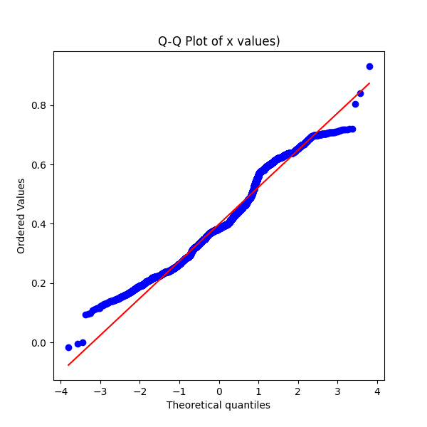
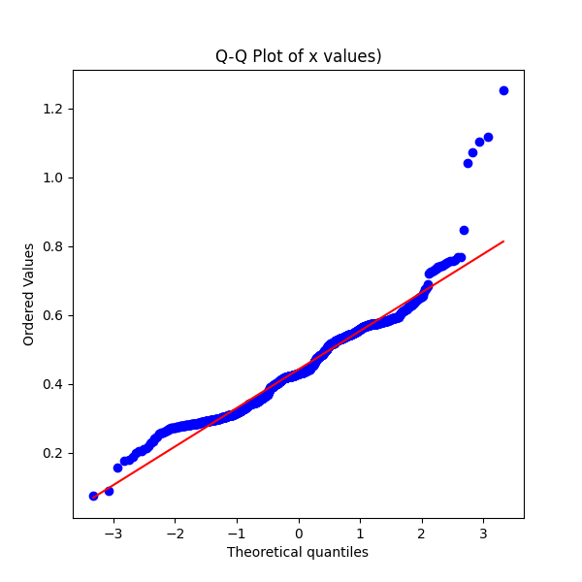
08-off
08-on

Slide 10
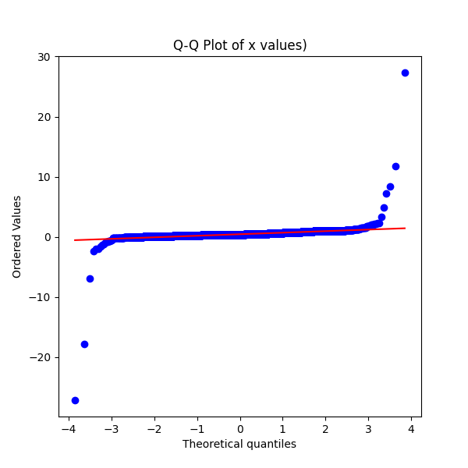
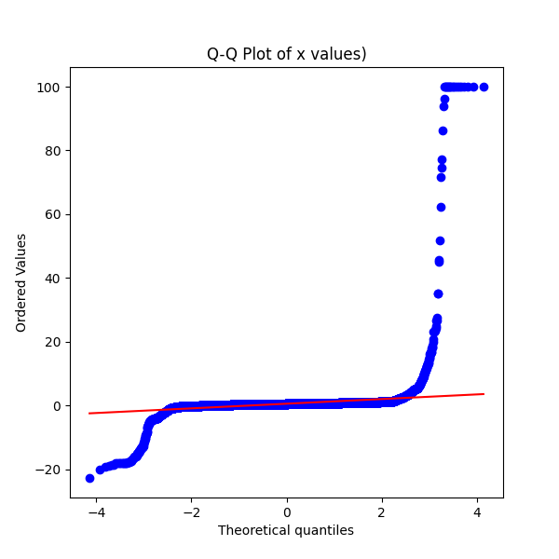
10-off
10-on

Slide 11
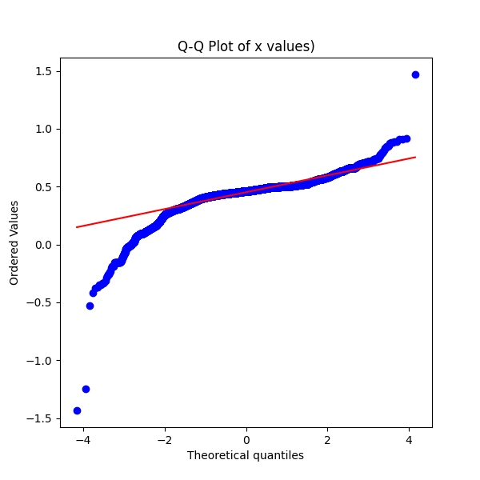
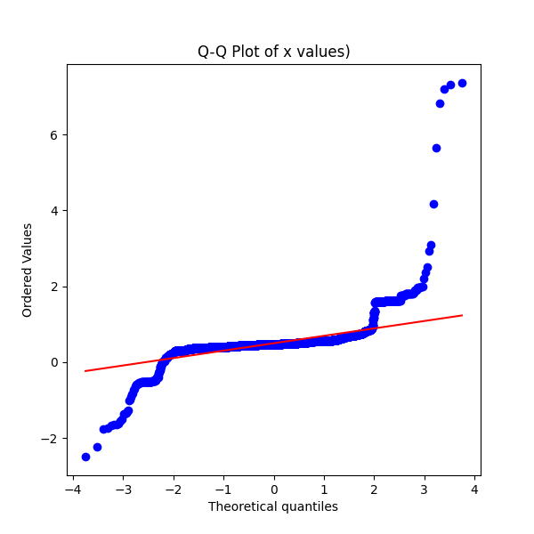
1-EC
2-EC

Slide 12
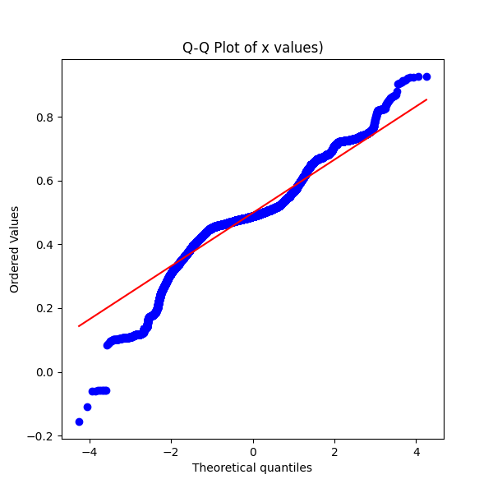
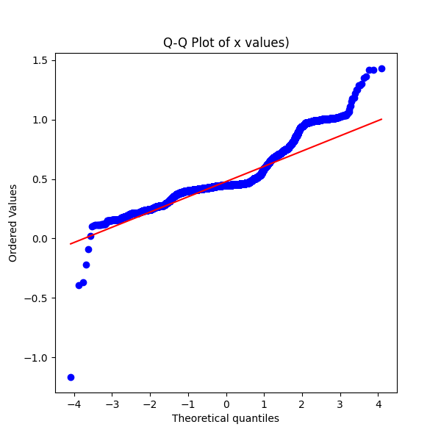
3-EC
4-EC

Slide 13
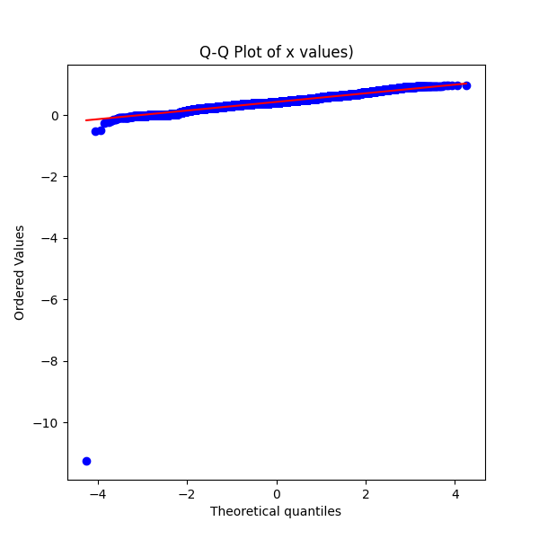
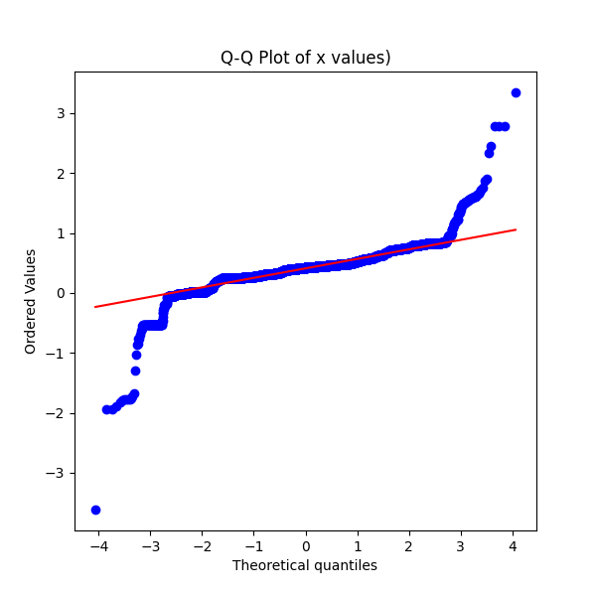
5-EC
6-EC

Slide 14
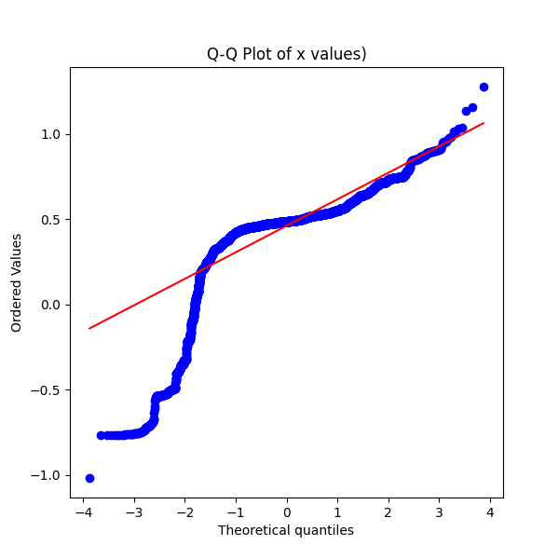
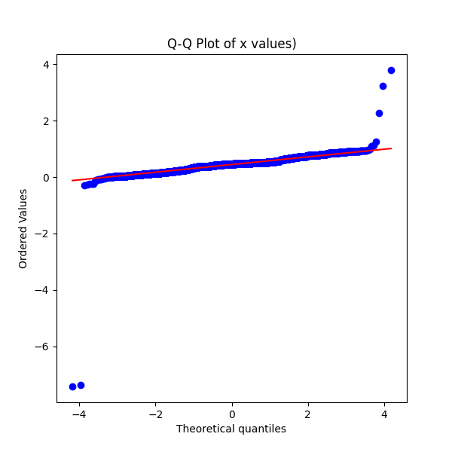
7-EC
8-EC

Slide 15
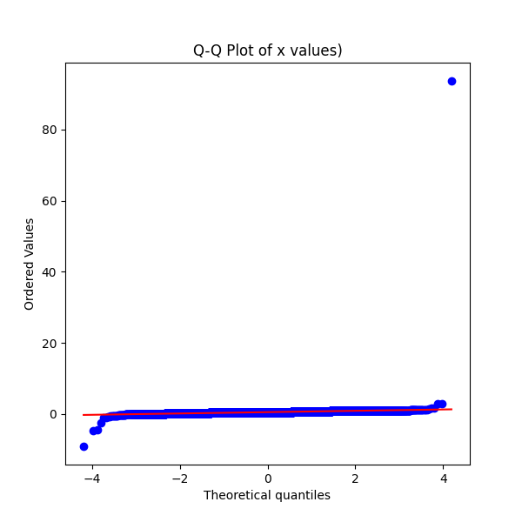
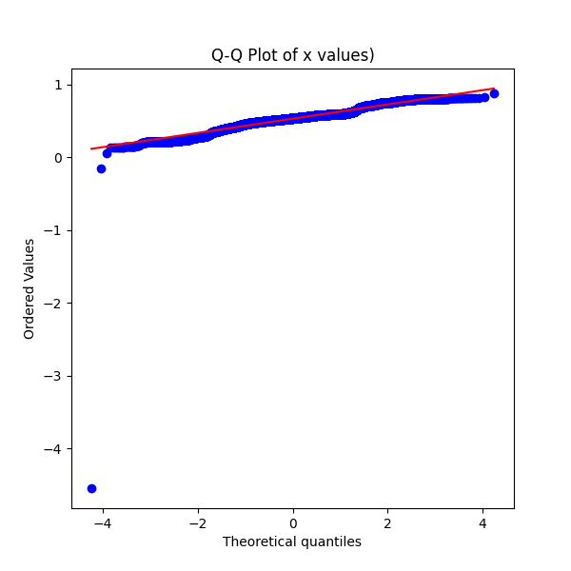
9-EC
10-EC

Slide 16
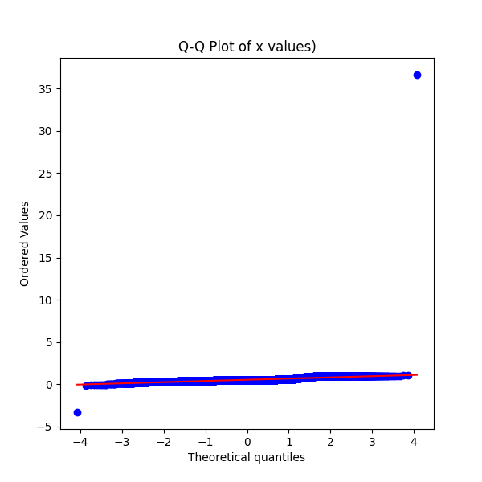
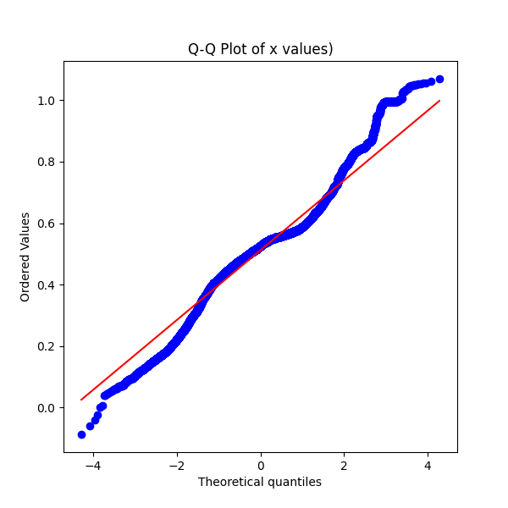
11-EC
12-EC

Slide 17
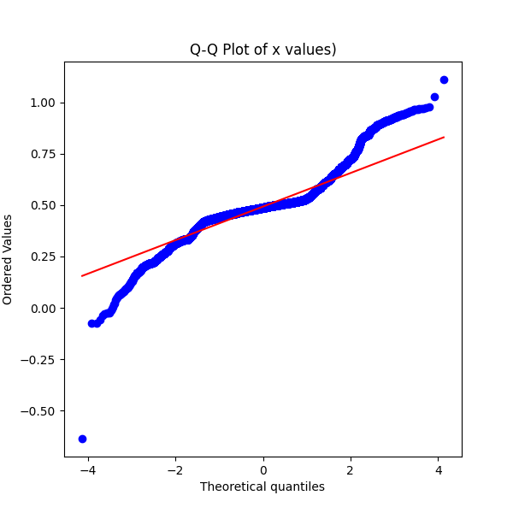
13-EC

